Slide 1
Multiplication

Slide 2
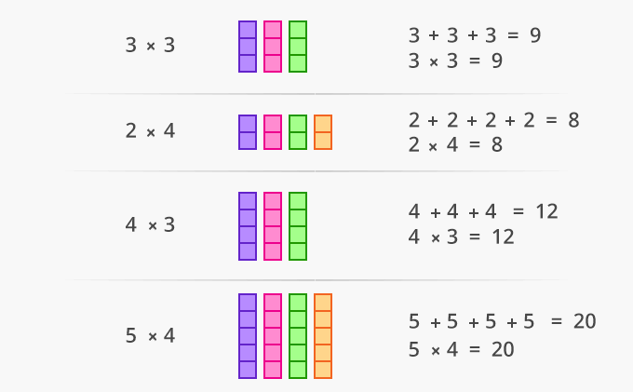
Idea

Slide 3
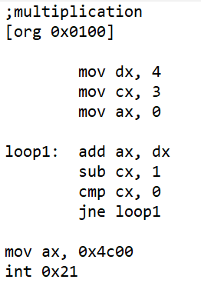
Multiplication

Slide 4
Sorting Algorithms

Slide 5
Selection Sort
Idea:
Find the smallest element in the array
Exchange it with the element in the first position
Find the second smallest element and exchange it with the element in the second position
Continue until the array is sorted
8
4
6
9
2
3
1
1
2
3
4
9
6
8
1
4
6
9
2
3
8
1
2
3
4
6
9
8
1
2
6
9
4
3
8
1
2
3
4
6
8
9
1
2
3
9
4
6
8
1
2
3
4
6
8
9

Slide 6
Selection Sort Pseudo code
Alg.: SELECTION-SORT(A)
n ← length[A]
for j ← 0 to n - 2
smallest ← j
for i ← j + 1 to n-1
if A[i] < A[smallest]
smallest ← i
exchange A[j] ↔ A[smallest]

Slide 7
Factorial

Slide 8
Factorial function
int fac(int numb)
{
int product=1;
while(numb>1)
{
product *= numb;
numb--;
}
return product;
}

